Slide 1
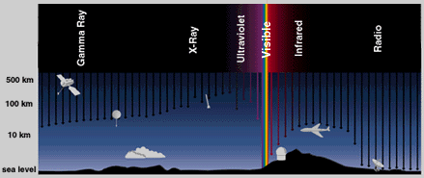
MULTI-WAVELENGTH OBSERVATION OF G351.417+0.645
BY EUGENE T-O OKWEI

Slide 2
INTRODUCTION
G351.417+0.645 has RA of 17h20m53.37s
And also declination of -35d47m01.2s
The source has VLSR:Min(-9.0), Max(0.11) rad.

Slide 3
INTRODUCTION CONT’D
We can classify methanol (CH3OH) masers into classes I and II. The key difference between the two lies in their excitation mechanisms. While class I CH3OH masers are excited by collisional processes, class II masers are radiatively excited.
There is high probability of finding class I CH3OH masers around outflow shock interfaces around protostellar objects while the class II CH3OH masers are found close to the central massive cores,sometimes with rotating (disk) structures.

Slide 4
LITERATURE INFORMATION
351.417+0.645 is a strong well-known maser which is projected on to the prominent compact H II region NGC 6334F.
Methanol masers are considered to be an excellent tracer of the early stages of massive star formation.
Methanol masers are well-known indicators of the early phases of high-mass star formation, in particular sources showing emission in the strong 6.7 GHz Class-II maser transition.

Slide 5
LITERATURE INFORMATION CONT’D
Methanol masers are found to be associated with a range of evolutionary stages of massive star formation.
Therefore, the low level of correlation could simply be a reflection of the spread in evolutionary stages covered by the methanol masers. It is also important to bear in mind that these methanol masers are likely to be associated with the circumstellar envelope/disc of a single embedded source.

Slide 6
LITERATURE INFORMATION CONT’D
The position of the maser is coincident with either low surface brightness, diffuse submillimetre emission, which would have been filtered out by the background subtraction used in the source-extraction process.
Our source is likely to be associated with a broad range of evolutionary states from HMCs to UC H II regions with their luminosity increasing through accretion as they develop.

Slide 7
LITERATURE INFORMATION CONT’D
Furthermore our source is associated with the thermal continuum emission from cold dust and likely tracing star formation; apparently dustless methanol maser which could be a combination of masers.

Slide 8
DISTANCE FROM THE LITERATURE
G351.417+0.645 has a distance of 0.39 arcsec

Slide 9
Spectral Energy Distribution
A tool to know the process of star formation is provided by the spectral energy distribution (SED) mainly in the near- and mid-infrared light
IR SEDs classified into three as Class I, Class II, and Class III, from a stand-point of relative importance of the radiation from a dust disk to the stellar black-body radiation

Slide 10
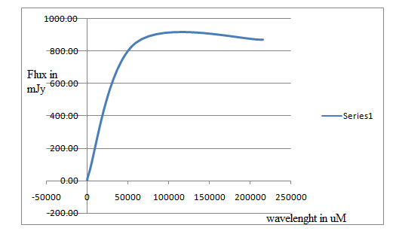
SED and Luminosity

Slide 11
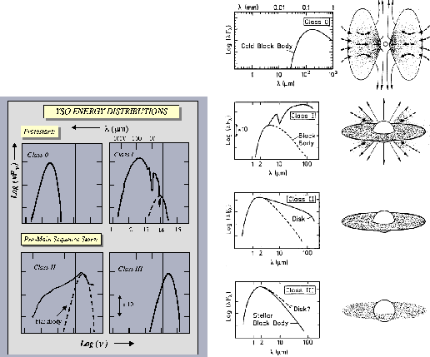
SED and Luminosity
(Cont’d)

Slide 12
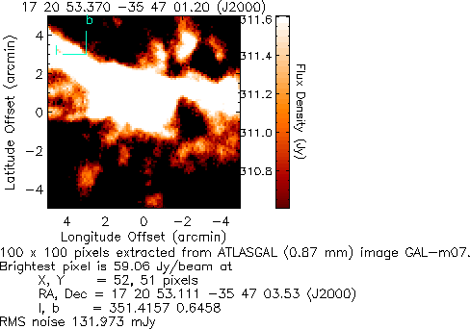
ATLASGAL survey (870micron)

Slide 13
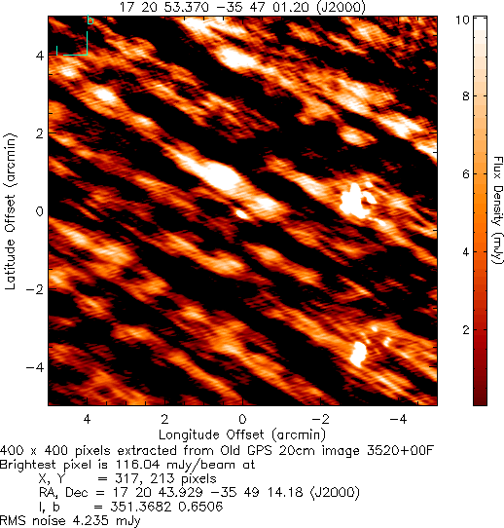
GPS survey (20cm)

Slide 14
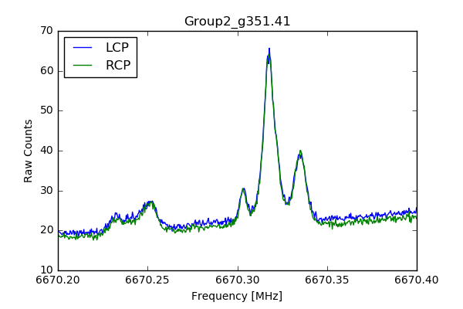
SPECTRAL LINE OF G351.41 FROM GRAO

Slide 15
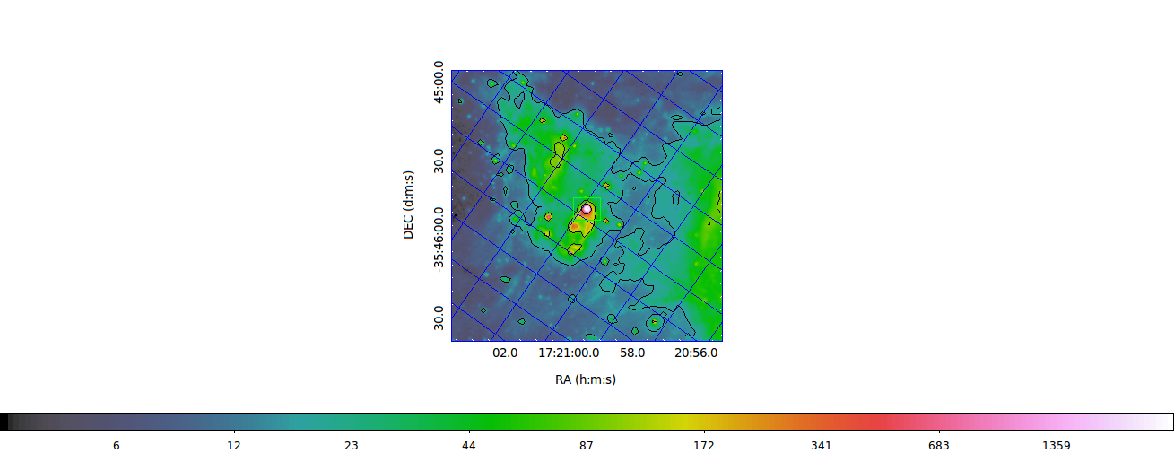
DISPLAY OF GLIMPSE SURVEY(MID IR)
GLIMPSE BAND I1(3.6micron)

Slide 16
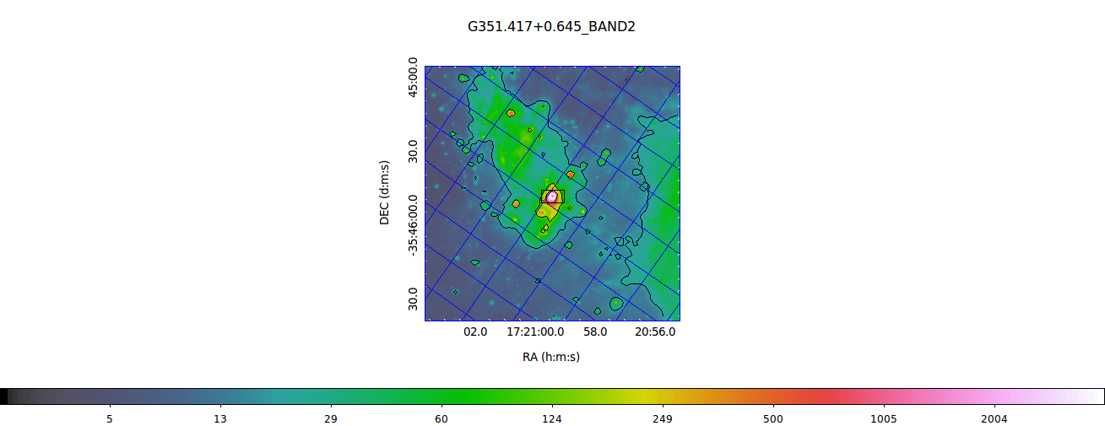
DISPLAY OF GLIMPSE SURVEY(MID IR)
GLIMPSE SURVEY BAND I2(4.5 micron)

Slide 17
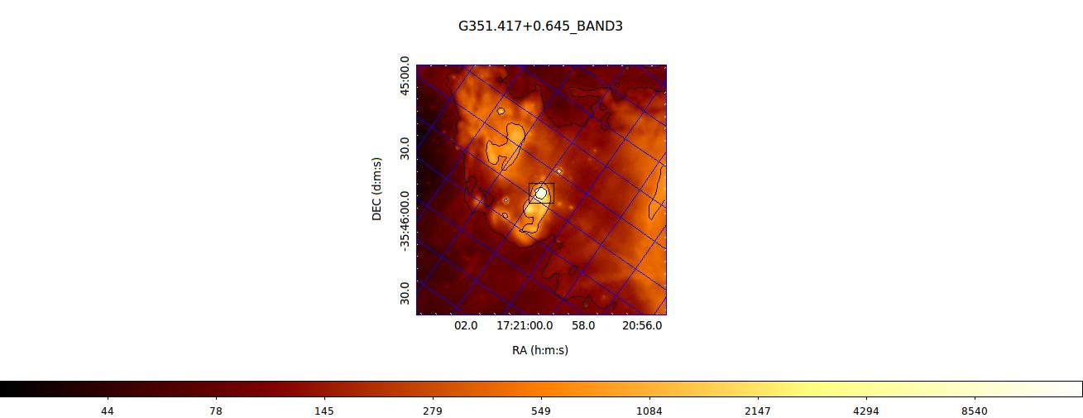
DISPLAY OF GLIMPSE SURVEY(MID IR)
GLIMPSE SURVEY BAND I3(5.8 micron)

Slide 18
DISPLAY OF GLIMPSE SURVEY(MID IR)
GLIMPSE SURVEY BAND I4(8 .0 micron)

Slide 19
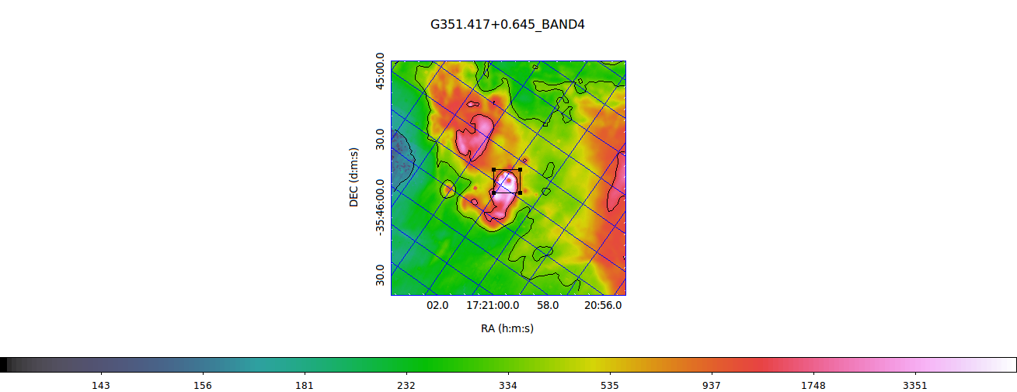
DISPLAY OF GLIMPSE SURVEY(MID IR)
GLIMPSE SURVEY BAND I4(8 .0 micron)

Slide 20
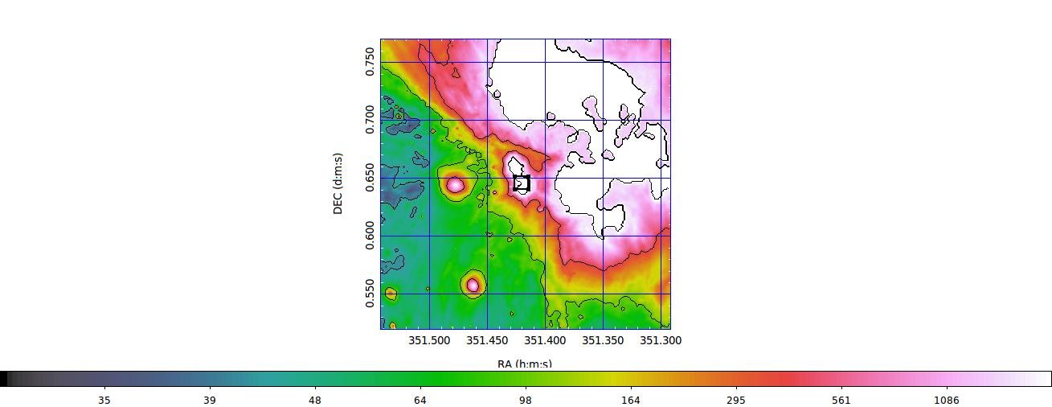
DISPLAY OF MIPSGAL (24 MICRON)
MIPSGAL I

Slide 21
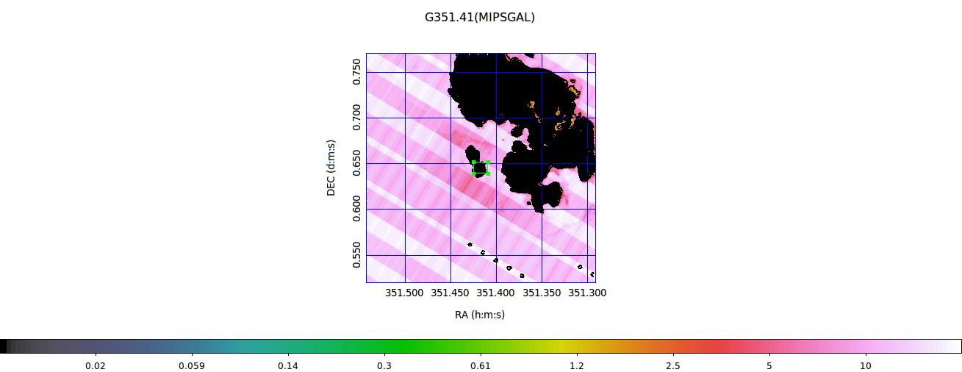
DISPLAY OF MIPSGAL (24 MICRON)
MIPSGAL II

Slide 22
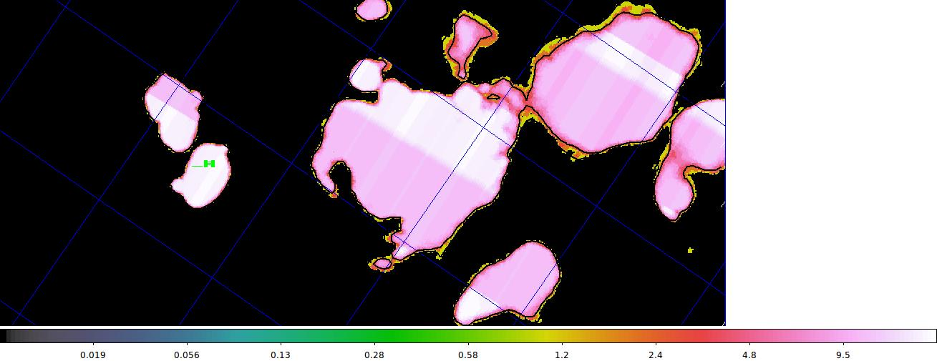
DISPLAY OF MIPSGAL (24 MICRON)
MIPSGAL III

Slide 23
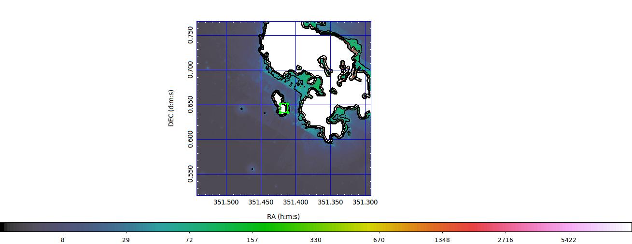
DISPLAY OF MIPSGAL (24 MICRON)
MIPSGAL IV

Slide 24
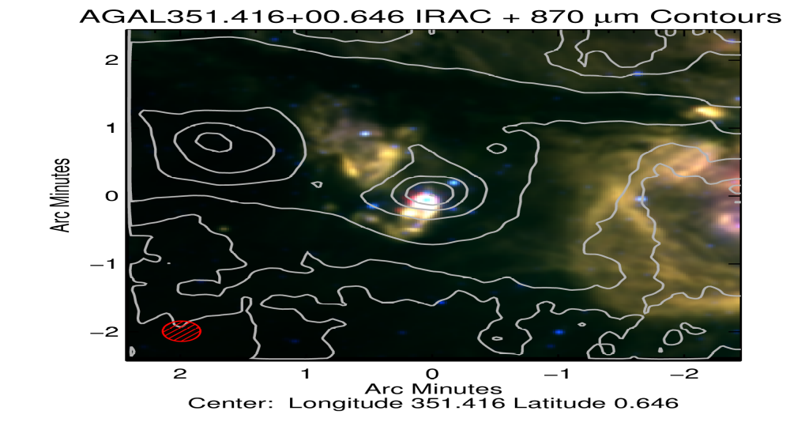
DISPLAY OF ATLASGAL SURVEY (Sub-mm wavelength)

Slide 25
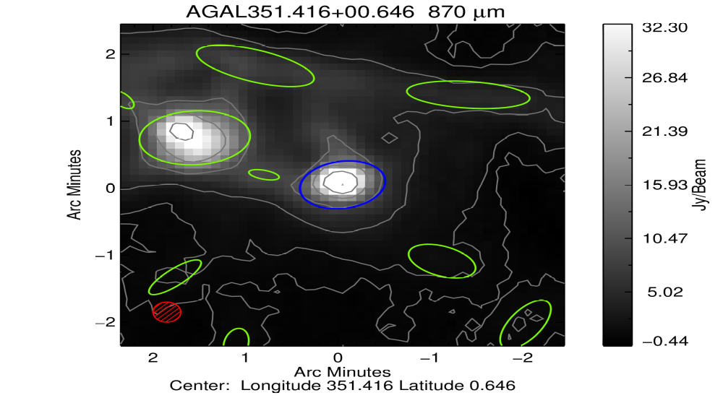
DISPLAY OF ATLASGAL SURVEY II (Sub-mm wavelength)

Slide 26
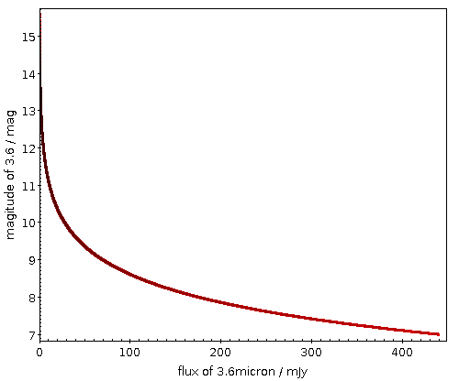
Plot of the Magnitude at 3.6 mag against the Flux at 3.6 micron

Slide 27

Plot of the Magnitude at 4.5 mag against the Flux at 4.5 micron

Slide 28
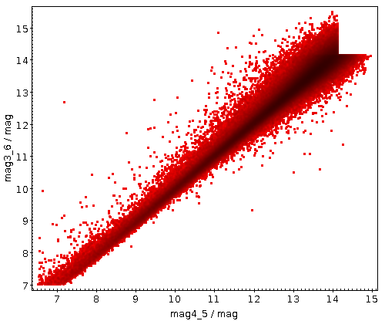
Plot of the Magnitude of 4.5 mag against the Magnitude of 3.6 mag

Slide 29
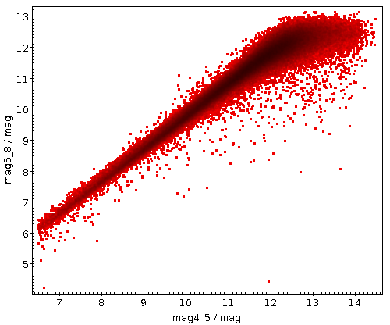
Plot of the Magnitude of 4.5 mag against the Magnitude of 5.8 mag

Slide 30
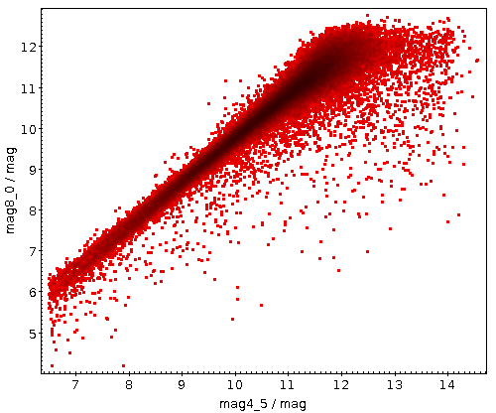
Plot of the Magnitude of 4.5 mag against the Magnitude of 8.0 mag

Slide 31
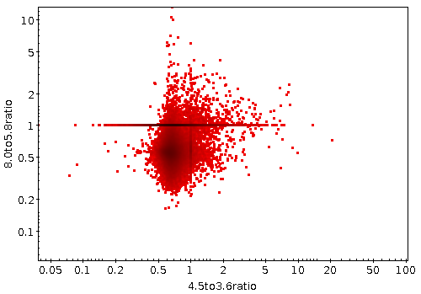
Plot of the Flux at (4.5/3.6) against Flux at (8.0/4.5)

Slide 32

Location of G351.41 on Galactic Plane

Slide 33
CONCLUSIONS
G351.417+0.645 is a strong well-known maser which is projected on to the prominent compact H II region.
G351.417+0.645 was found to be associated with a range of evolutionary stages of massive star formation.
G351.417+0.645 is considered to be an excellent tracer of the early stages of massive star formation.

Slide 34
REFERENCES
Brand J., Blitz L. A&A ,1993, 275, 67
Chibueze, J. O., Imai, H., Tafoya, D., et al. 2012, ApJ, 748, 146Green J. A. et al MNRAS, 2009, 392, 783
Cragg, D. M., Johns, K. P., Godfrey, P. D., & Brown, R. D. 1992, MNRAS,259, 203
Higuchi, A. E., Hasegawa, T., Saigo, K., Sanhueza, P., & Chibueze, J. O. 2015, ApJ, 815, 106
Ilee, J. D., Cyganowski, C. J., Nazari, P., et al. 2016, arXiv:1608.05561Menten K. M. ApJ, 1991, 380, L75

Slide 35
REFERENCES
McClure-Griffiths N. M., Dickey J. M., Gaensler B. M., Green A. J., Haverkorn M., Strasser S ApJS , 2005, 158, 178
Minier V., Ellingsen S. P., Norris R. P., Booth R. S. A&A , 2003, 403, 1095
Plambeck, R. L., & Menten, K. M. 1990, ApJ, 364, 55
Reid M. J. et al ApJ , 2009, 700, 137
Sánchez-Monge, Á., Cesaroni, R., Beltrán, M. T., et al. 2013, A&A, 552 L10

Slide 36

THANK YOU

